Slide 1
PowerBi Beginner
Faz Karim

Slide 2
Lesson 1: Introducing Power BI
Navigating the Interface
Importing from Data Sources
Building a Report Using Data
Shaping, Transforming and Combining Data
Using Power Query
Producing Reports Using your Data Transformations
Notes:
Learning Outcomes:
Import well-formed data into Power BI Desktop
Build reports with stunning visuals
Publish a report to the Power BI service on Office 365
Create and edit query steps in Power Query
Learn basic data transformation tools
Combine data from different data sources and tables

Slide 3

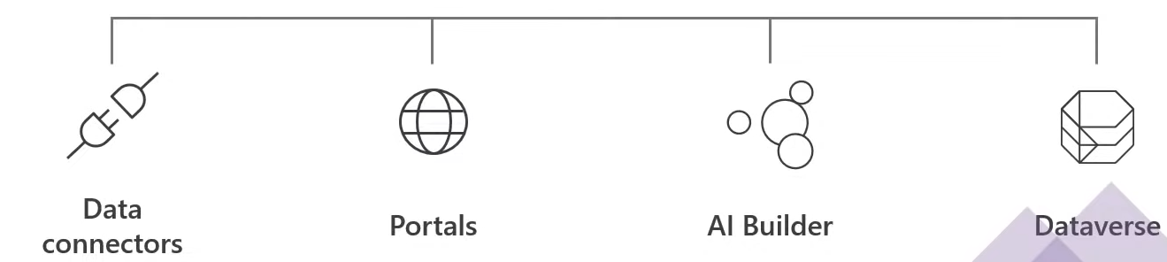
Microsoft Power Platform
The Low Code Platform that spans Office 365, Azure Dynamics 365 and standalone applications Innovation anywhere, Unlocks Value everywhere
Notes:
Power Platform.
Power Bi - Reporting tool that builds visual on top of your data
Power Apps - Rapid application Development tool
Power Automate - create flows or trigger events that kick off a process based off your tool initiating
Power Virtual Agents - build your own AI chatbot you have designed.
Designed for business users

Slide 4

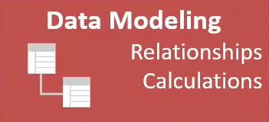
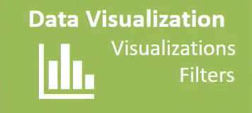

Power BI Project Phases
This power query tool is used to CLEAN the data. So this step essentially would be prep step for the data.
We created the calendar table but have yet to establish relationships!
We created some viz, slicers bookmarks, up next a tooltip!!
Notes:
Power Query - clean and prep the data as it comes it.
Connect and create relationship between our data sets across platforms
DAX - data analysis expression language
Creating Reports, Filtering, Story Telling
Licensing to share on both ends. Even if embed in SharePoint or teams

Slide 5
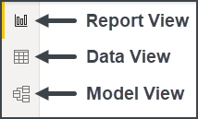
The Power BI Main Components
Power Bi is made up of three main components:
The Report View
The Data View
The Model View

Slide 6
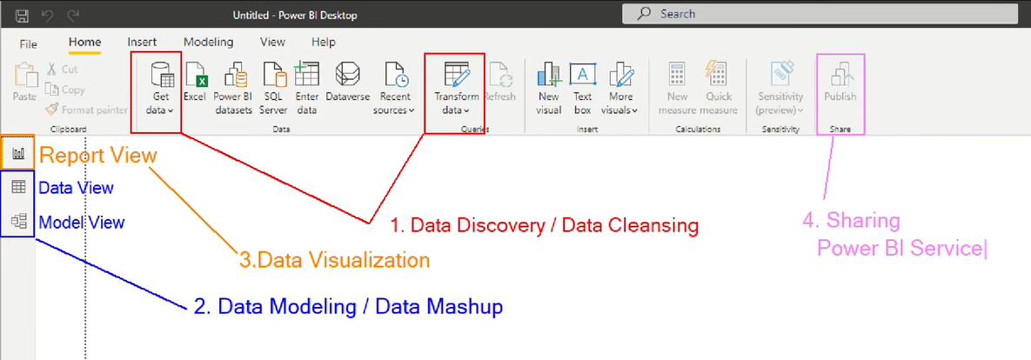
Power Bi Interface
Notes:
A breakdown of all 4 phases of a BI Project within the interface

